Slide 1
Previous works on CNN
0712238 林彥彤

Slide 2
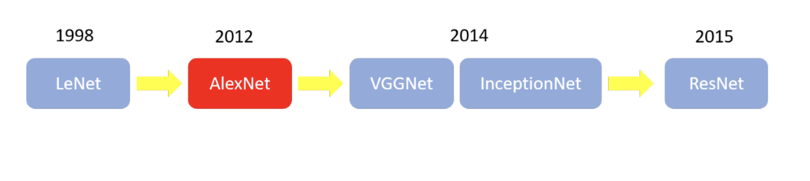
Previous Works(0)

Slide 3
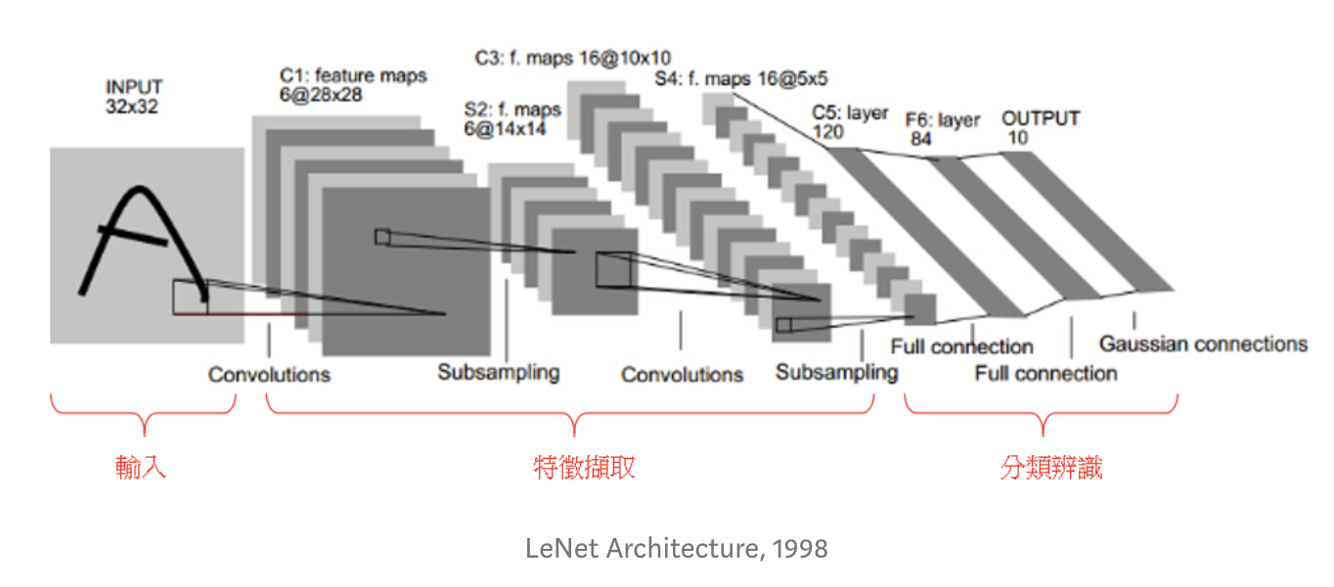
Previous Works(1) - Lenet
Father of CNN
Conv layer
Pooling

Slide 4
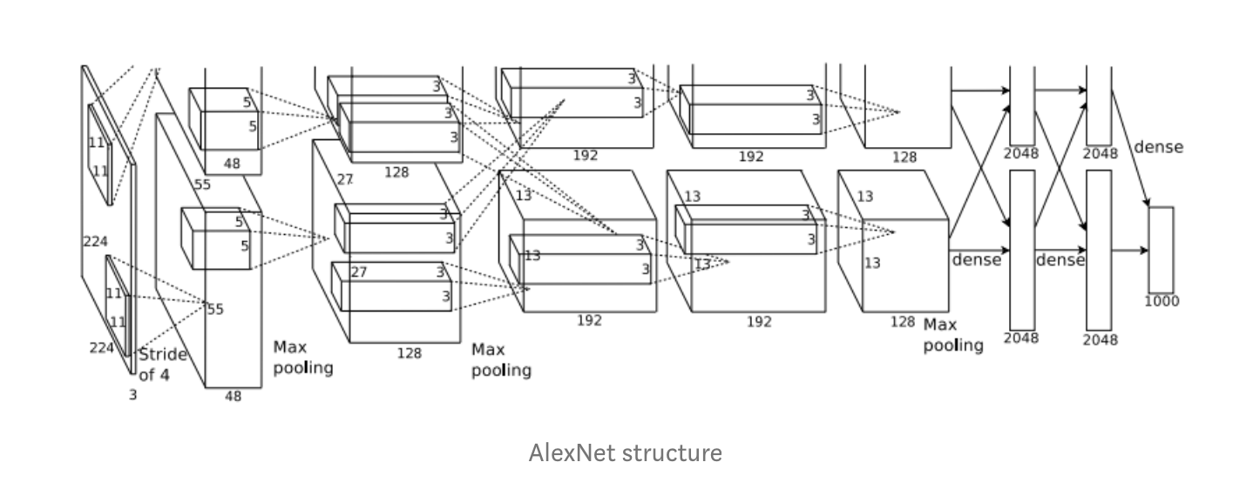
Previous Works(2) - Alex Net
2012 ImageNet LSVRC Champion
CNN start to thrive
RELU
LRN
Huge # of Params
Data Augmentation
Drop out
GPU parallelization
Notes:
Long time
NN win
thrive
Relu , hugh # of params combined with data….

Slide 5
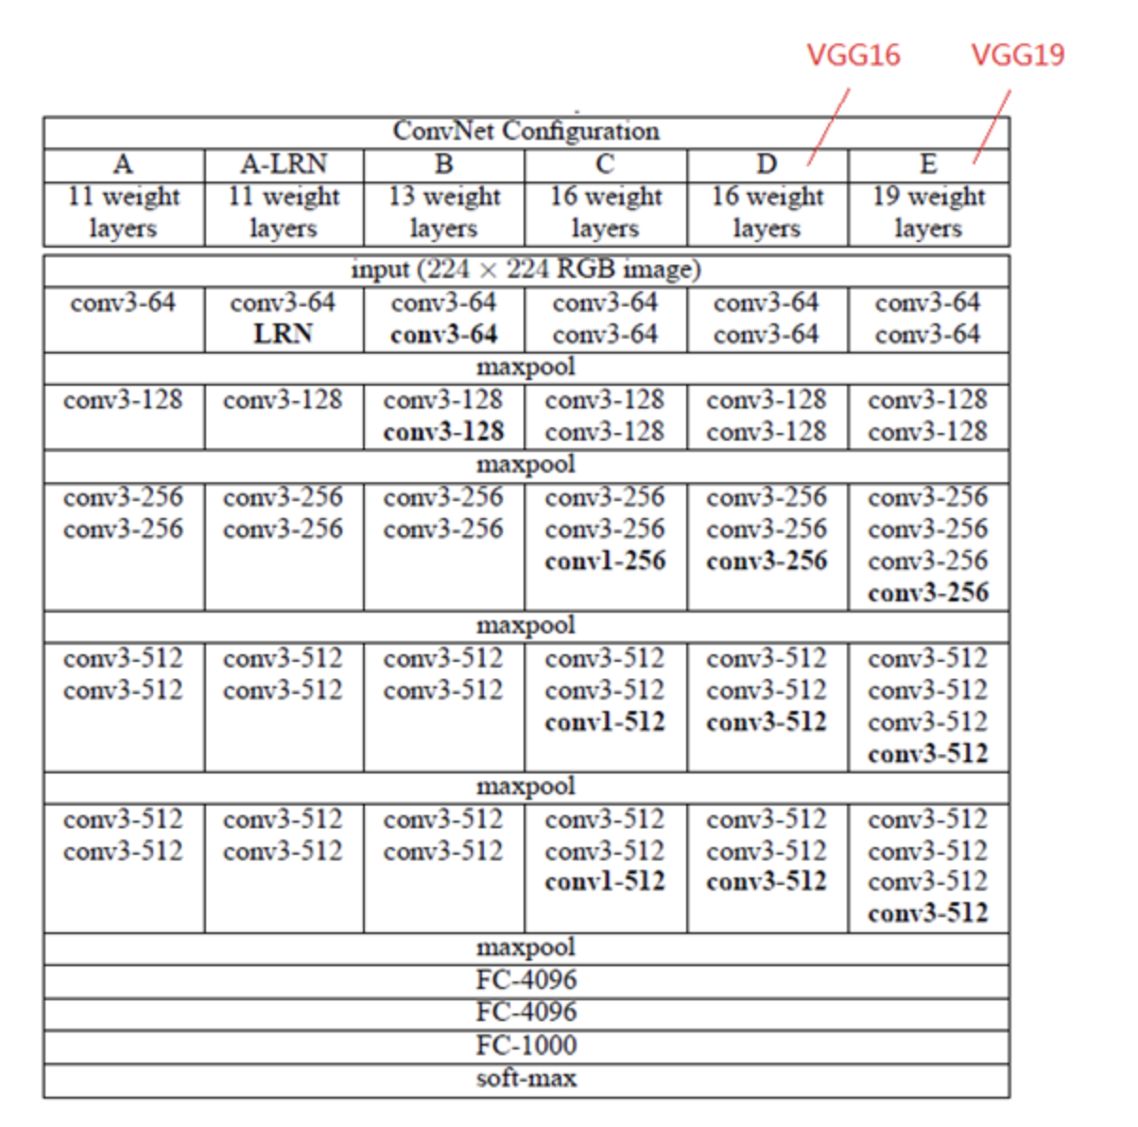
Previous Works(3) – VGC Net
2014 ILSVRC 2nd place
“Deepened” net work
Deeper =>Better
3.3 conv + 2.2 max pool
3 times params of Alex net
Notes:
Deeper is better, similar architecture

Slide 6
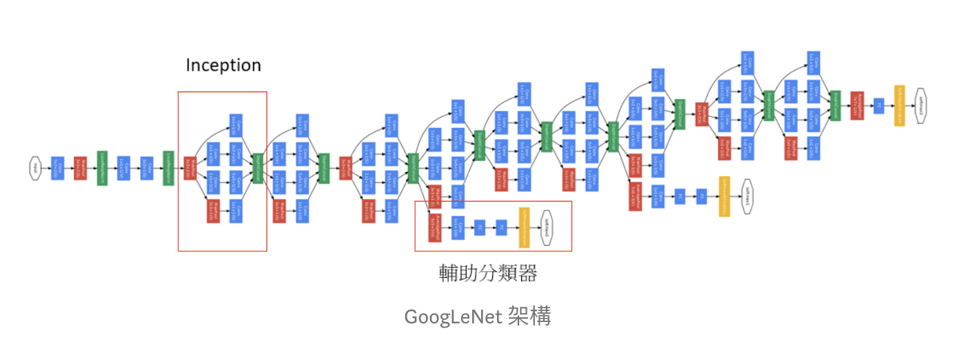
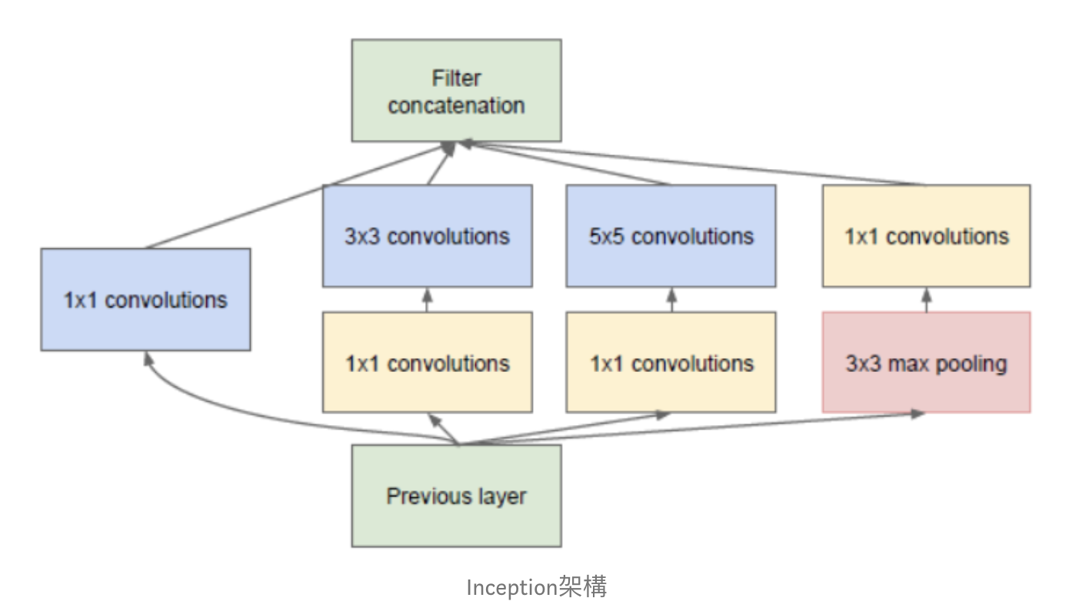
Previous Works(4) – Inception(GoogLeNet)
2014 ILSVRC champion
Not just deepening
(But still deepening)
Concept of Inception
New Block(Network In Network)
Average Pooling instead of FC
Auxiliary Classifiers for Gradient Vanishing
Deeper =>Better
Smaller params size compared to AlexNet

Slide 7
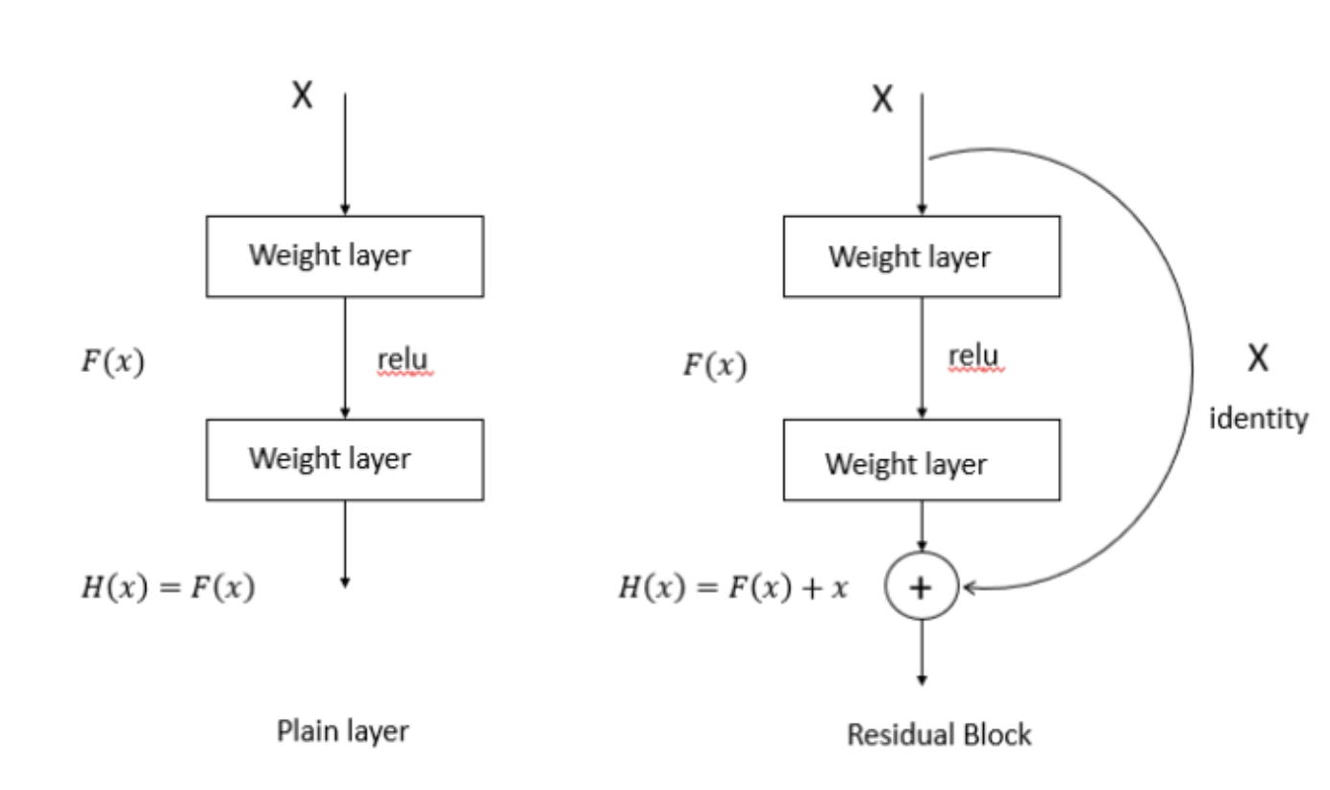
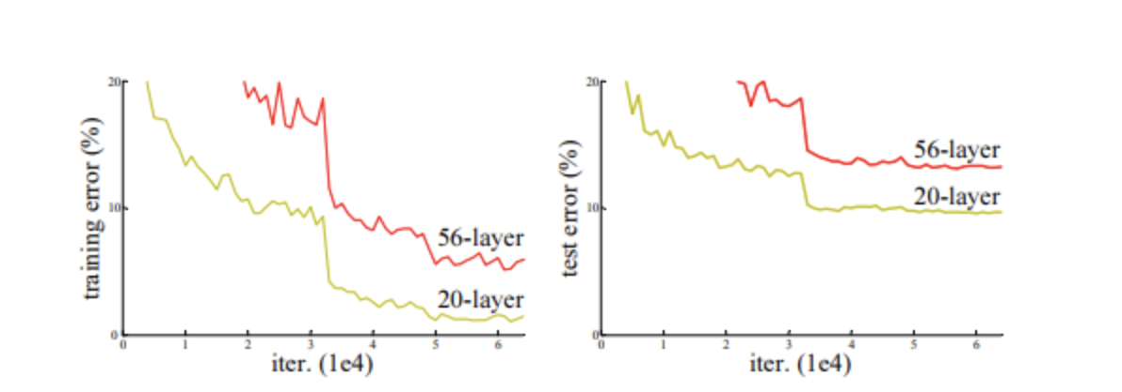
Previous Works(5) – Deep ResNet
Always Deeper =>Better??
Gradient vanishing

Slide 8
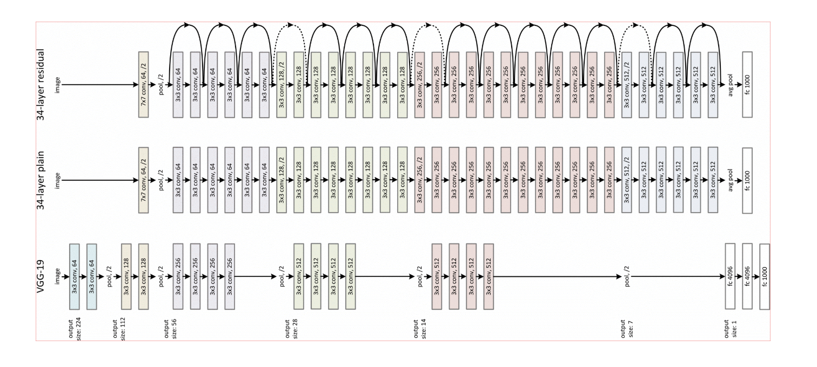
Previous Works(6) – Deep ResNet(cont.)
Deeper
Solve Gradient Vanish

Slide 9
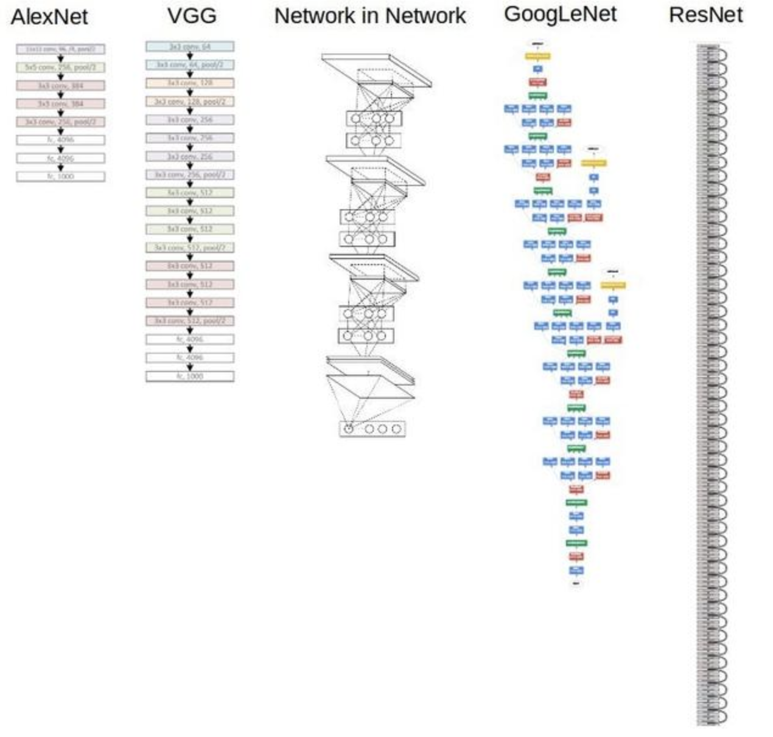

Slide 10
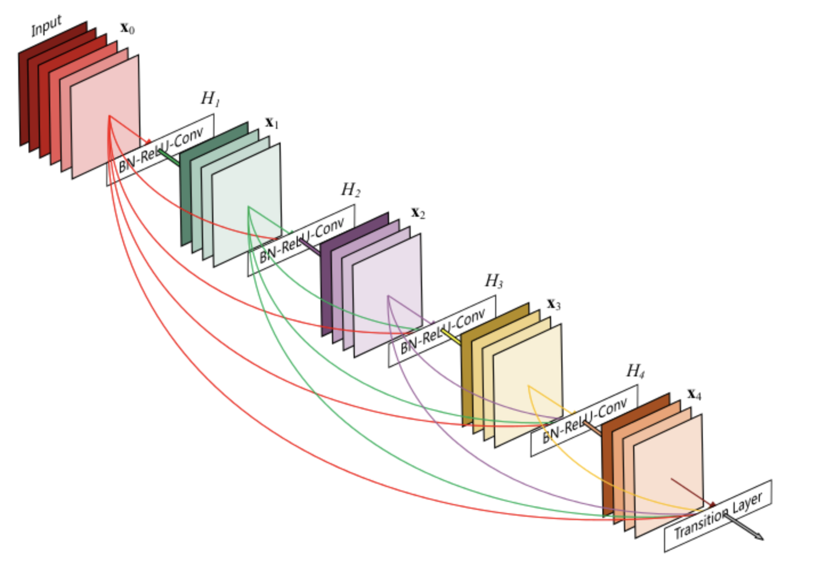
The paper - Dense Net
Full connection in between
Reuse data to reduce computation

